Slide 1
Announcements
Project 1: Search
Due Fri 9/16 at 5:00pm.
Solo or in group of two. See Piazza for instructions.
(Optional) Project 1 Mini-Contest
Due Sun 9/18 at 11:59pm.
Homework 3: Game Trees
Due Mon 9/19 at 11:59pm.
Midterm 1: Thursday October 6, 7-9pm
See Piazza if you need to reschedule.

Slide 2
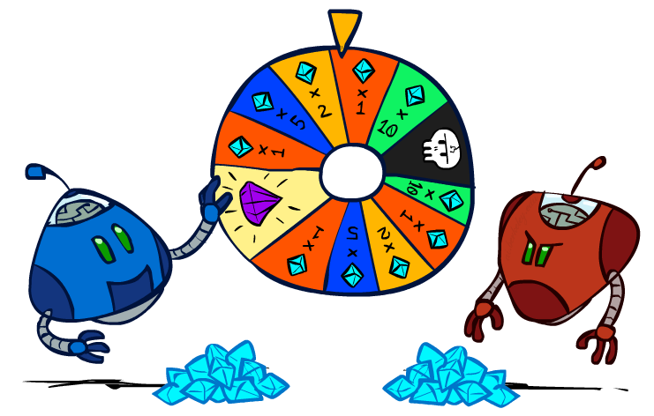
CS 188: Artificial Intelligence
Uncertainty and Utilities
Instructors: Josh Hug & Adam Janin
University of California, Berkeley
[These slides were created by Dan Klein, Pieter Abbeel, Anca Dragan for CS188 Intro to AI at UC Berkeley (ai.berkeley.edu).]
Notes:
Please retain proper attribution, including the reference to ai.berkeley.edu. Thanks!

Slide 3
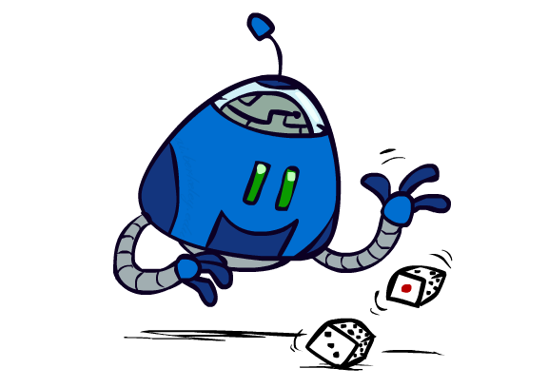
Uncertain Outcomes
Notes:
Search and planning with uncertainty. Not everything under control. Dice, cards, even dumb oppenent.

Slide 4
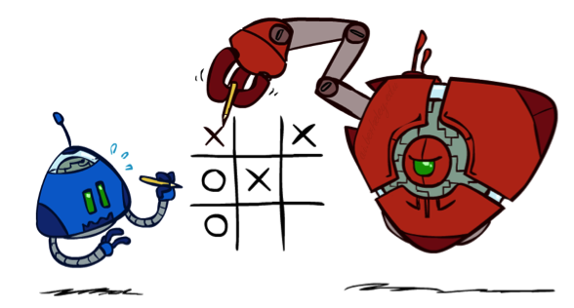

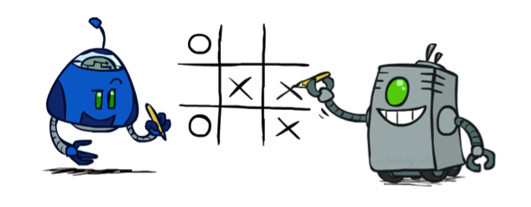
Worst-Case vs. Average Case
max
min
10
10
9
100
Idea: Uncertain outcomes controlled by chance, not an adversary!
Notes:
How to reason when opponent is perfectly adversarial. I can predict what she’ll do.
5 year old. Roll dice.
New node – chance, rather than min or max.

Slide 5
Expectimax Search
Why wouldn’t we know what the result of an action will be?
Explicit randomness: rolling dice
Unpredictable opponents: the ghosts respond randomly
Actions can fail: when moving a robot, wheels might slip
Values should now reflect average-case (expectimax) outcomes, not worst-case (minimax) outcomes
Expectimax search: compute the average score under optimal play
Max nodes as in minimax search
Chance nodes are like min nodes but the outcome is uncertain
Calculate their expected utilities
I.e. take weighted average (expectation) of children
Later, we’ll learn how to formalize the underlying uncertain-result problems as Markov Decision Processes
max
10
54
chance
10
10
4
10
5
8
7
100
[Demo: min vs exp (L7D1,2)]
Notes:
How much bigger? Depends on how likely 8 is vs. 100.
Assume equal.
Chance nodes still out of player 1’s control, but expected rather than best play for opponent.

Slide 6
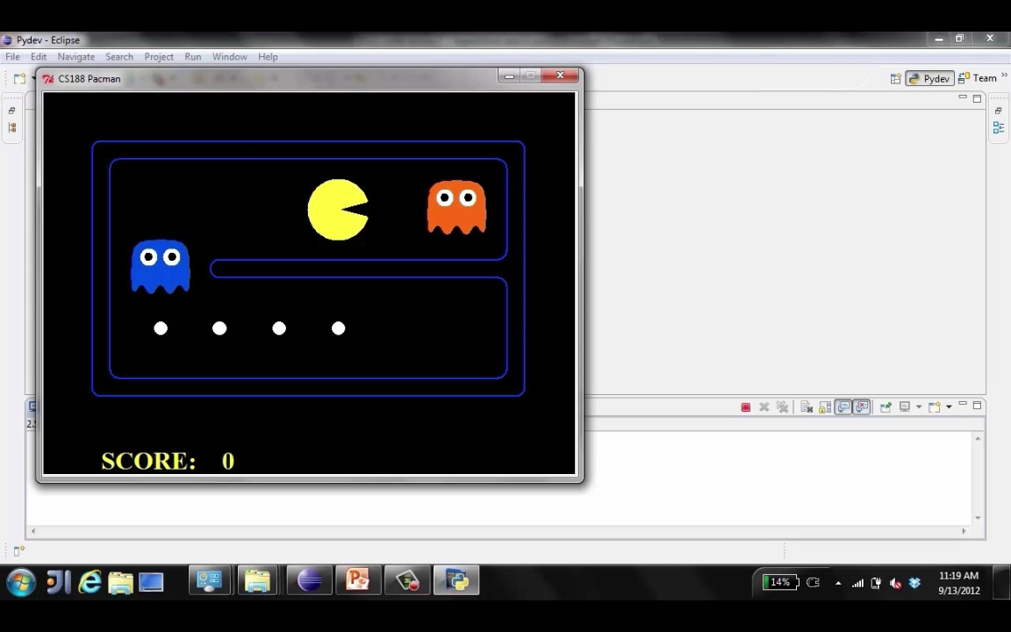
Video of Demo Minimax vs Expectimax (Min)
Notes:
Two strategies: dive bomb, or hope ghosts make a mistake. (Video 23s in)
If ghosts are min/max, no chance. Die fast.

Slide 7
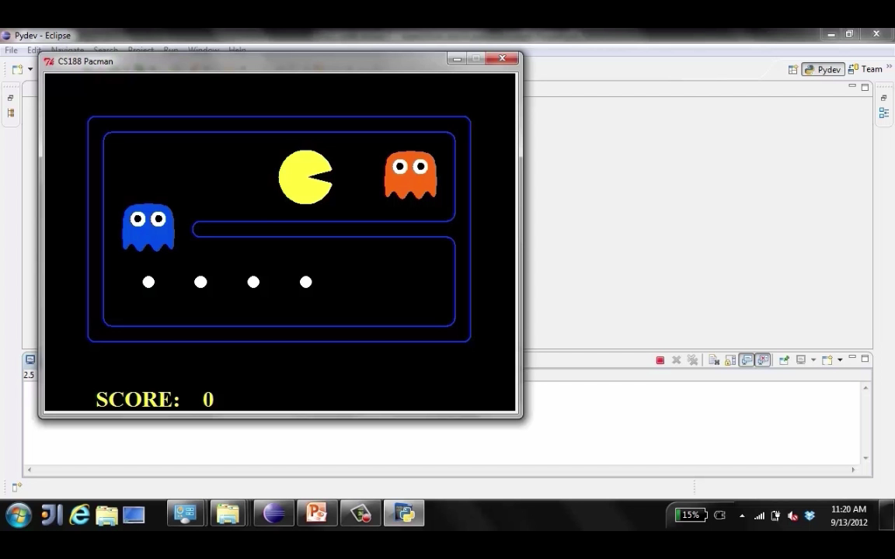
Video of Demo Minimax vs Expectimax (Exp)
Notes:
Now ghosts are random. If blue happens to go up, you’re gonna loose. But only one point worse than dive bombing.
If blue goes down, lotsa juicy dots to eat.
First try, random against us. Rational, but no guarantee! Try again. Hope!
(Video 36s in)

Slide 8
Expectimax Pseudocode
def value(state):
if the state is a terminal state: return the state’s utility
if the next agent is MAX: return max-value(state)
if the next agent is EXP: return exp-value(state)
def max-value(state):
initialize v = -∞
for each successor of state:
v = max(v, value(successor))
return v
def exp-value(state):
initialize v = 0
for each successor of state:
p = probability(successor)
v += p * value(successor)
return v
Notes:
Value is expectimax, not minimax.
Very similar to code before, but dispatch has EXP.
You could still include MIN, as we’ll see later.
Zoom in on exp-value..

Slide 9
Expectimax Pseudocode
def exp-value(state):
initialize v = 0
for each successor of state:
p = probability(successor)
v += p * value(successor)
return v
1/2
1/6
1/3
5
8
7
24
-12
v = (1/2) (8) + (1/3) (24) + (1/6) (-12) = 10
Notes:
As anybody in a big family knows, not all children are equal.

Slide 10
Expectimax Example
8
8
4
7
3
12
9
2
4
6
15
6
0
Notes:
Long side down – max
Circle – average
Tasty 15. Terrible 0. But circles are random!
Might get 3; might get 12.

Slide 11
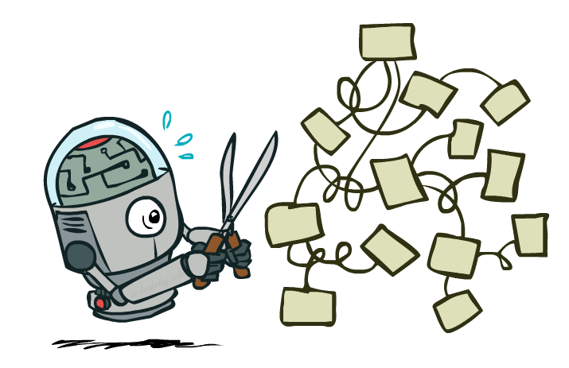
Expectimax Pruning?
8
3
12
9
2
Notes:
Already so good or bad, don’t need to explore more?
If it were min, could we prune! Yes, <= 2 if min.
But not with expectimax.
All tangled up.
If you have bounds, you might be able to do something (e.g. no scores bigger than 12).

Slide 12



Depth-Limited Expectimax
Estimate of true expectimax value (which would require a lot of work to compute)
400
300
…
…
492
362
…
Notes:
Big game tree. Can’t build tree explicitly, can’t explore all the way to end.
Random ghosts. Two layers, one for each ghost.
Terminal nodes are scores. Known by game. But can’t search that deep. So we limit horizon.
So we need ESTIMATE of true value. Exact value is too hard – what we’re trying to solve.

Slide 13
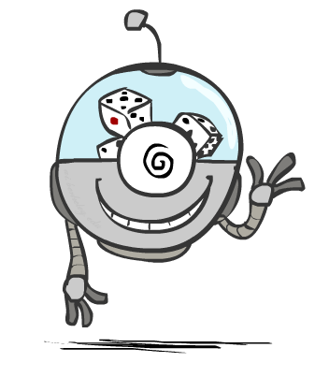
Probabilities

Slide 14
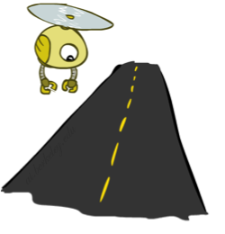
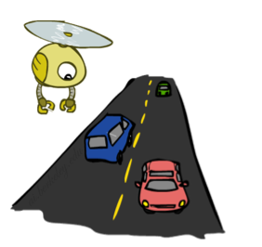
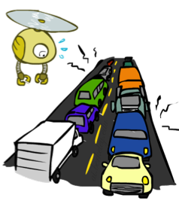
Reminder: Probabilities
A random variable represents an event whose outcome is unknown
A probability distribution is an assignment of weights to outcomes
Example: Traffic on freeway
Random variable: T = whether there’s traffic
Outcomes: T in {none, light, heavy}
Distribution: P(T=none) = 0.25, P(T=light) = 0.50, P(T=heavy) = 0.25
Some laws of probability (more later):
Probabilities are always non-negative
Probabilities over all possible outcomes sum to one
As we get more evidence, probabilities may change:
P(T=heavy) = 0.25, P(T=heavy | Hour=8am) = 0.60
We’ll talk about methods for reasoning and updating probabilities later
0.25
0.50
0.25
Notes:
Already a model; not density. Model is not world!
If 880, terrible model. Better is prob(T=heavy) == 1!
Probabilistic inference later.

Slide 15
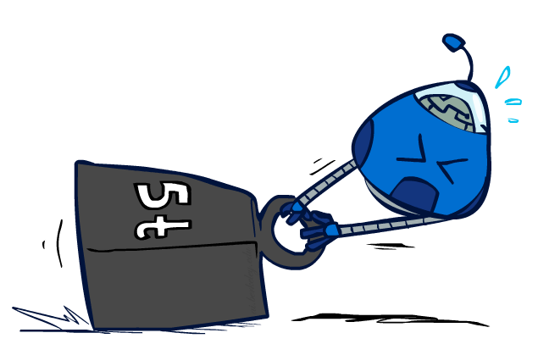
Reminder: Expectations
The expected value of a function of a random variable is the average, weighted by the probability distribution over outcomes
Example: How long to get to the airport?
Time:
20 min
30 min
60 min
+
+
35 min
x
x
x
Probability:
0.25
0.50
0.25
Notes:
Function of the traffic!
Just what we’ve been doing at chance nodes.

Slide 16

What Probabilities to Use?
In expectimax search, we have a probabilistic model of how the opponent (or environment) will behave in any state
Model could be a simple uniform distribution (roll a die)
Model could be sophisticated and require a great deal of computation
We have a chance node for any outcome out of our control: opponent or environment
The model might say that adversarial actions are likely!
For now, assume each chance node magically comes along with probabilities that specify the distribution over its outcomes
Having a probabilistic belief about another agent’s action does not mean that the agent is flipping any coins!
Notes:
~10:00
Might be VERY complex – Big neural net
Probability of adversarial.

Slide 17
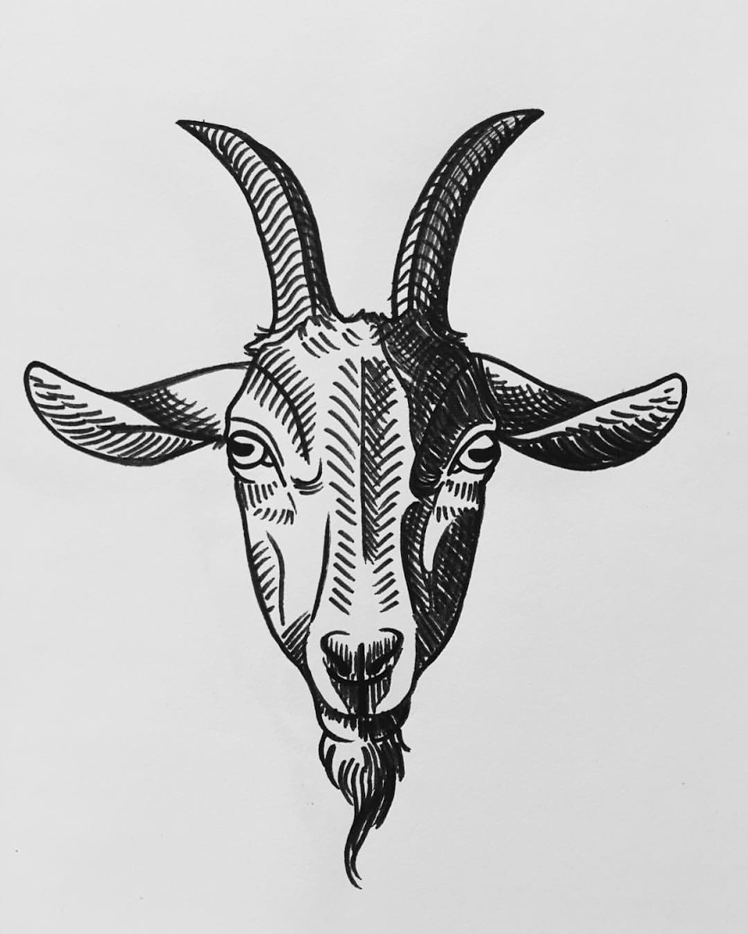
Quiz: Informed Probabilities
Let’s say you know that your opponent is actually running a depth 2 minimax, using the result 80% of the time, and moving randomly otherwise
Question: What tree search should you use?
Answer: Expectimax!
To figure out EACH chance node’s probabilities, you have to run a simulation of your opponent
This kind of thing gets very slow very quickly
Even worse if you have to simulate your opponent simulating you…
… except for minimax, which has the nice property that it all collapses into one game tree
0.1 0.9
Notes:
Expectimax is more general.
Computing probabilities can be expensive!
Every exp node spawns a minimax.

Slide 18
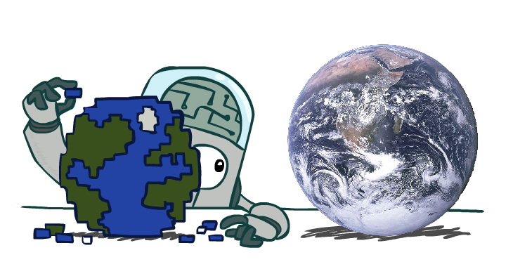
Modeling Assumptions
Notes:
How we think the world works, what computation?
Utilities, chance probabilities, are they adversarial or not?!?

Slide 19
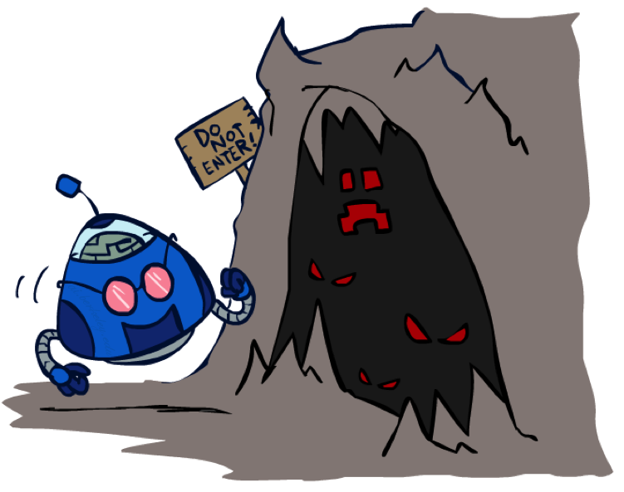
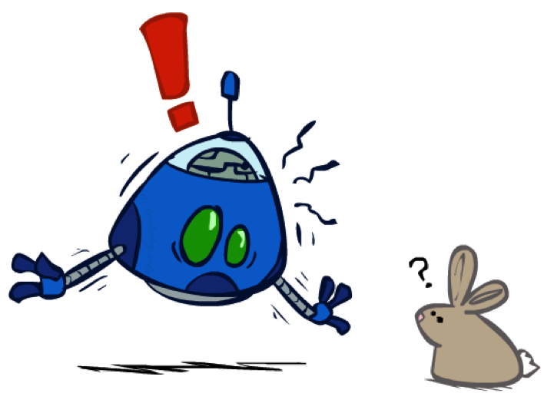
The Dangers of Optimism and Pessimism
Dangerous Optimism
Assuming chance when the world is adversarial
Dangerous Pessimism
Assuming the worst case when it’s not likely
Notes:
The world really IS out to get you!
Might be a vorpal bunny!

Slide 20
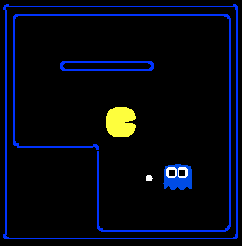
Assumptions vs. Reality
 | Adversarial Ghost | Random Ghost
Minimax Pacman | Matched, Hard | Pessimistic
Expectimax Pacman | Optimistic | Matched, Easy
Pacman used depth 4 search with an eval function that avoids trouble Ghost used depth 2 search with an eval function that seeks Pacman
[Demos: world assumptions (L7D3,4,5,6)]
Notes:
python pacman.py -g SmartGhost -l trapped2 -p ExpectimaxAgent -a depth=4,evalFn=better
”hard” in the sense of optimal adversary. “Easy” in the sense that the ghost isn’t out to get you.

Slide 21
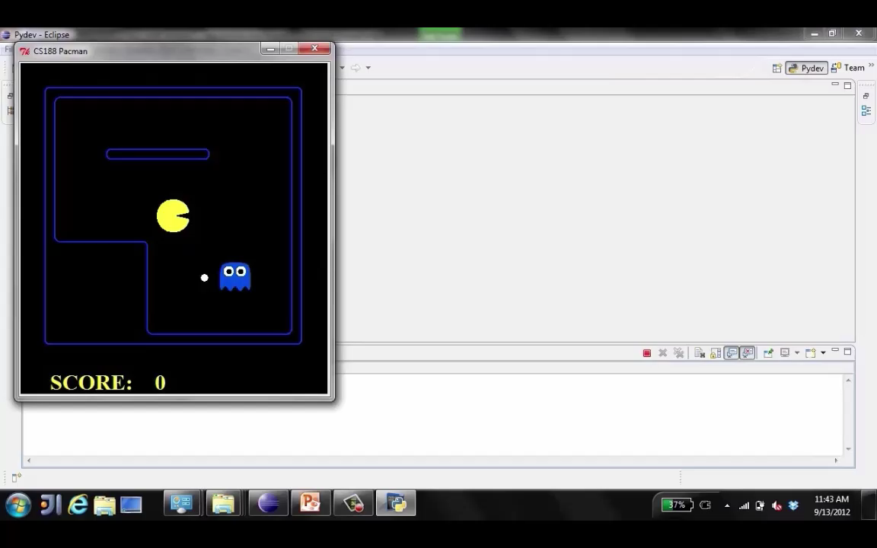
Video of Demo World Assumptions Random Ghost – Expectimax Pacman
Notes:
Matched, Easy
Straight for dot. Ghost is random. Mostly works out.

Slide 22
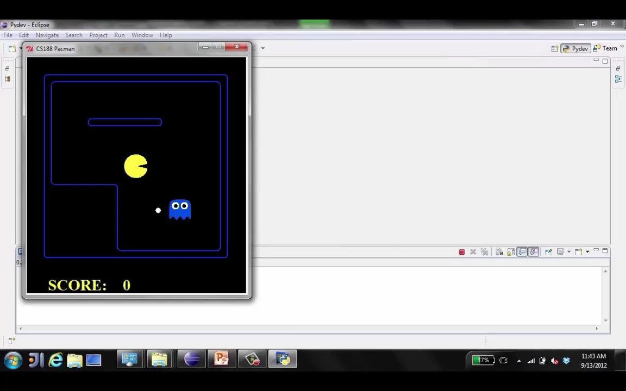
Video of Demo World Assumptions Adversarial Ghost – Minimax Pacman
Notes:
Matched, Hard
Smart ghost, and you know it! Run away, run away!
On this board, you can win (and know it)
Takes longer. World worse.

Slide 23
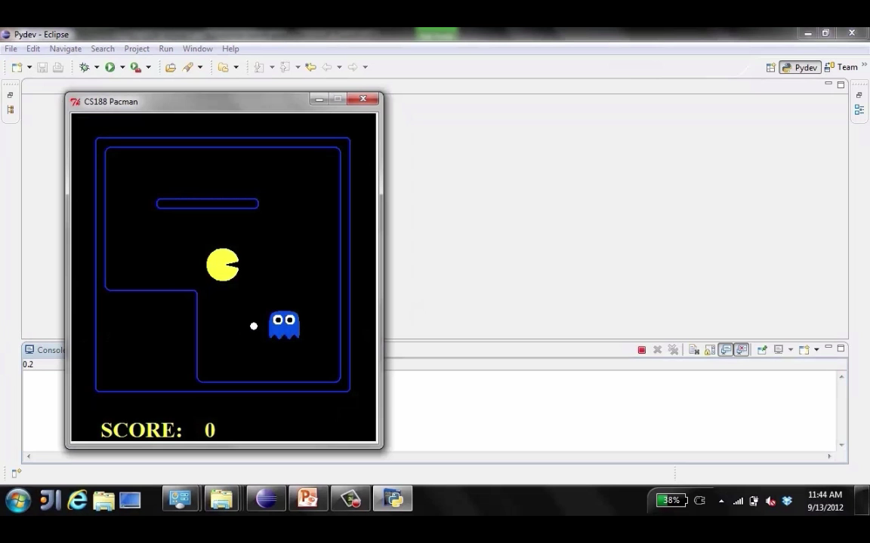
Video of Demo World Assumptions Adversarial Ghost – Expectimax Pacman
Notes:
Optimistic
Uh, oh. The ghost is smart, but you think it’s random. Might work out.

Slide 24
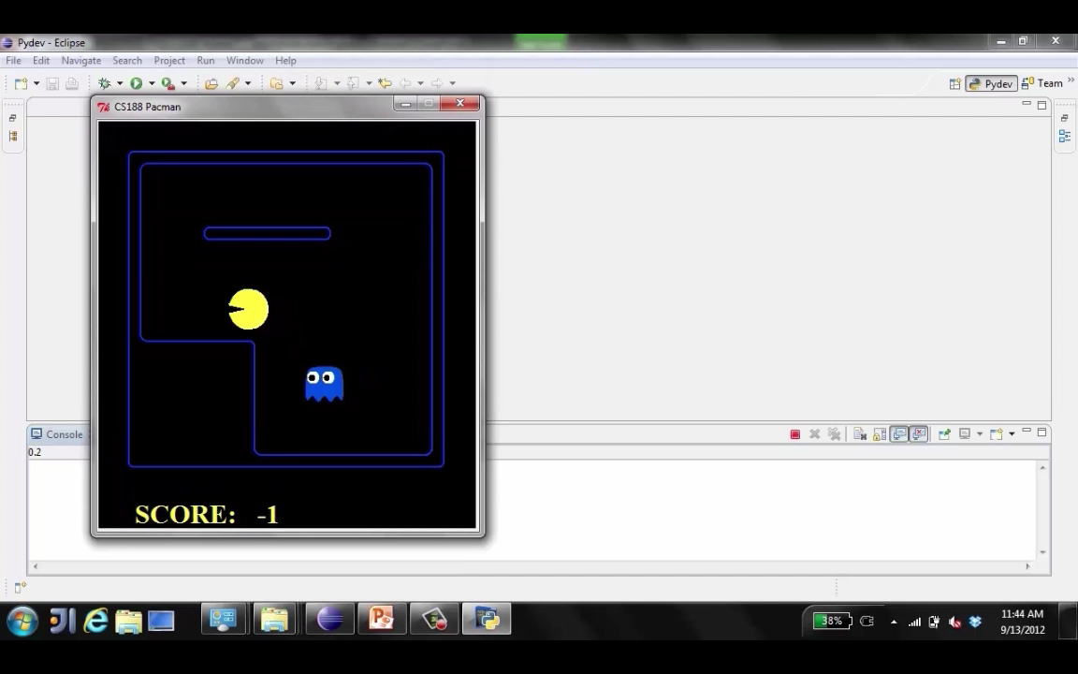
Video of Demo World Assumptions Random Ghost – Minimax Pacman
Notes:
Pessimistic. You think it’s a Vorpil bunny, but it’s just a random bunny.
Scared. Any moment now!
C’mon random number generator.

Slide 25
Which is Easiest? Which is Hardest?
 | Adversarial Ghost | Random Ghost
Minimax Pacman | Won 5/5 Avg. Score: 483 | Won 5/5 Avg. Score: 493
Expectimax Pacman | Won 1/5 Avg. Score: -303 | Won 5/5 Avg. Score: 503
Results from playing 5 games
Pacman used depth 4 search with an eval function that avoids trouble Ghost used depth 2 search with an eval function that seeks Pacman
[Demos: world assumptions (L7D3,4,5,6)]
Notes:
Take a moment and discuss what you think the scores will be (the order, not the values)? If you played a bunch of games, when would you mostly win?
You’ll do stuff like this in the project.

Slide 26
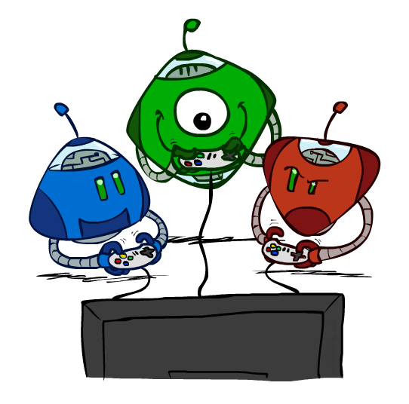
Other Game Types
Notes:
Not talk about ALL games. Later with partial info.

Slide 27



Mixed Layer Types
E.g. Backgammon
Expectiminimax
Environment is an extra “random agent” player that moves after each min/max agent
Each node computes the appropriate combination of its children
Notes:
If it’s terminal or we reached our depth limit, return utility

Slide 28
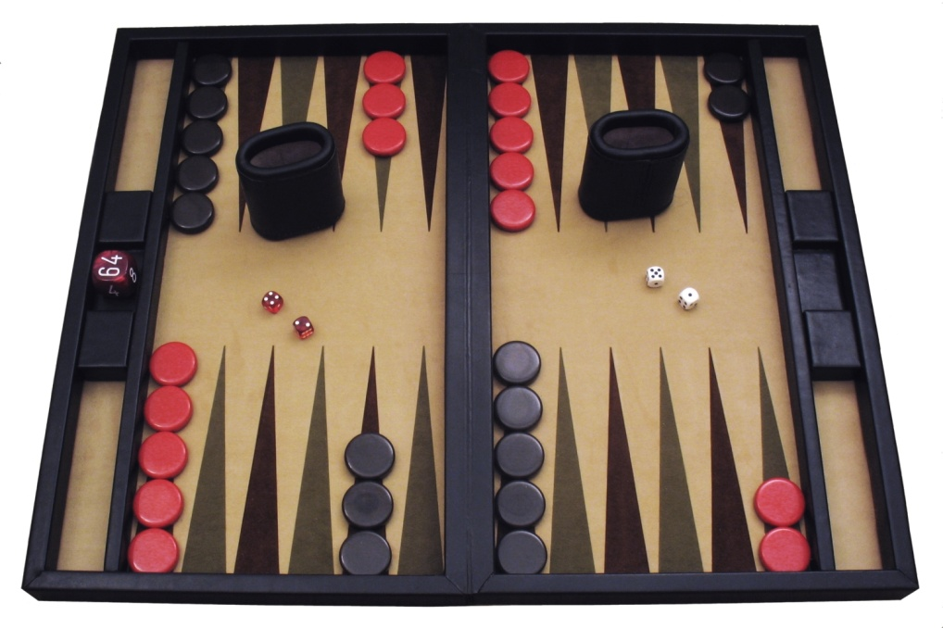
Example: Backgammon
Dice rolls increase b: 21 possible rolls with 2 dice
Backgammon ≈ 20 legal moves
Depth 2 = 20 x (21 x 20)³ = 1.2 x 10⁹
As depth increases, probability of reaching a given search node shrinks
So usefulness of search is diminished
So limiting depth is less damaging
But pruning is trickier…
Historic AI: TDGammon uses depth-2 search + very good evaluation function + reinforcement learning: world-champion level play
1st AI world champion in any game!
Image: Wikipedia
Notes:
Can’t guarantee you’ll reach any node, so a lot of searching ahead doesn’t really help.

Slide 29
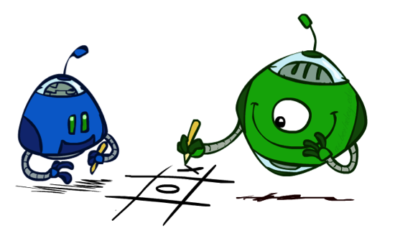
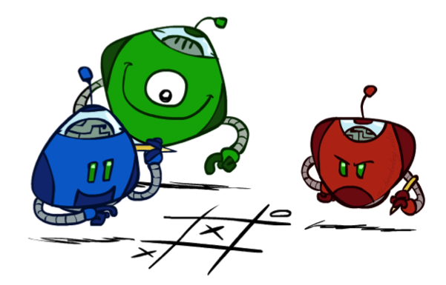
Multi-Agent Utilities
What if the game is not zero-sum, or has multiple players?
Generalization of minimax:
Terminals have utility tuples
Node values are also utility tuples
Each player maximizes its own component
Can give rise to cooperation and
competition dynamically…
5,2,5
1,6,6
5,2,5
1,6,6
6,1,2
5,1,7
5,2,5
1,6,6
7,1,2
6,1,2
7,2,1
5,1,7
1,5,2
7,7,1
5,2,5
Notes:
Can’t have one number. How much state is worth to each player.
In lower left, looks like green and blue ganging up on red, but no communication except through terminal utilities.
Green and blue in lower right.
Final red and green.
Complex emergent behavior from computation!

Slide 30
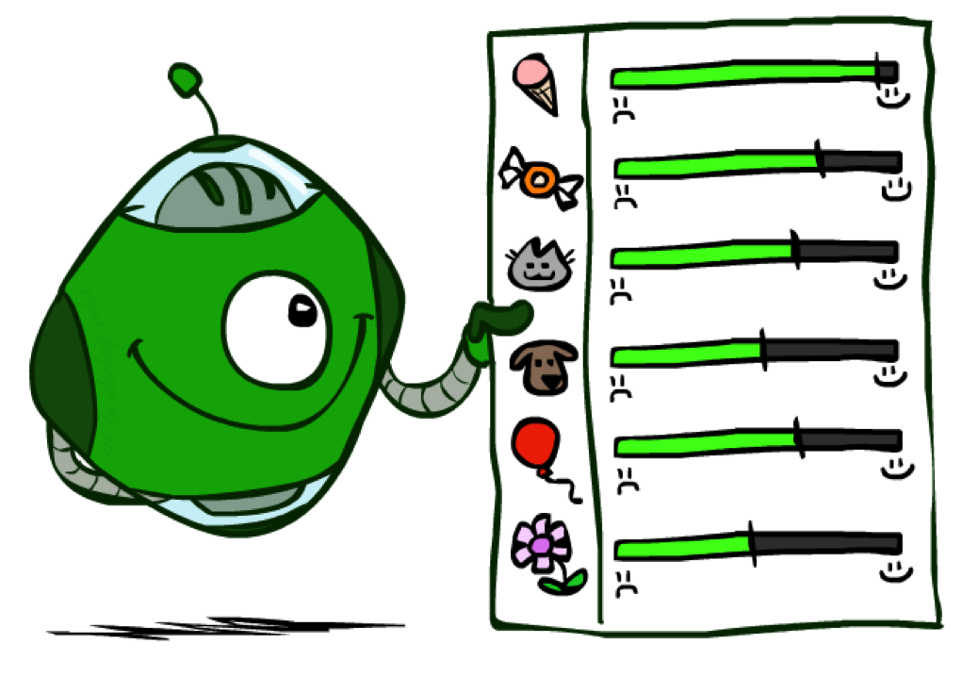
Utilities
Notes:
~10:20

Slide 31

Maximum Expected Utility
Why should we average utilities? Why not minimax?
Principle of maximum expected utility:
A rational agent should chose the action that maximizes its expected utility, given its knowledge
Questions:
Where do utilities come from?
How do we know such utilities even exist?
How do we know that averaging even makes sense?
What if our behavior (preferences) can’t be described by utilities?
Notes:
Vorpil bunnies.
Should I go to Thai food or Italian food? I could go to Thai, but it’s spicy. But I might also get hit by a meteor. Italian, or abducted by aliens!
Worst case reasoning really bad. Need to have probabilities.
Behavior is too complex to use just a single number.

Slide 32
What Utilities to Use?
0
20
0
400
0
40
20
30
x²
0
1600
400
900
For worst-case minimax reasoning, terminal function scale doesn’t matter
We just want better states to have higher evaluations (get the ordering right)
We call this insensitivity to monotonic transformations
Notes:
For minimax, it is in a sense easy. The scale doesn’t matter, just the order.
Assumes equal probabilities.

Slide 33
What Utilities to Use?
20
25
800
650
0
40
20
30
x²
0
1600
400
900
For average-case expectimax reasoning, we need magnitudes to be meaningful
Sensitivity to monotonic transformations
Notes:
How about expectimax?
Squaring changed the answer! Go left instead of right.
So for expectimax, utilities matter a lot. What are they?

Slide 34

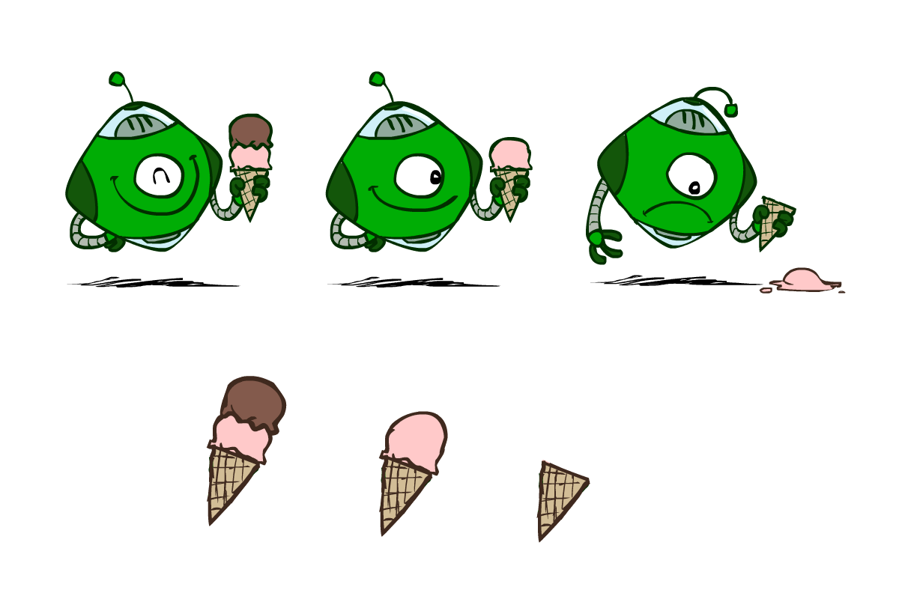
Utilities
Utilities are functions from outcomes (states of the world) to real numbers that describe an agent’s preferences
Where do utilities come from?
In a game, may be simple (+1/-1)
Utilities summarize the agent’s goals
Theorem: any “rational” preferences can be summarized as a utility function
We hard-wire utilities and let behaviors emerge
Why don’t we let agents pick utilities?
Why don’t we prescribe behaviors?
Notes:
Utilities in input. Behavior is output.
Vacuum cleaner pick it’s own utility? Just do nothing! Very happy, no electricity, doesn’t run over your cat.
But also doesn’t clean! Don’t want to tell it path – that’d be back to if/then rules. Let search algorithm do it.
Have to be careful! If utility is “picking up dirt”, vacuum could pick and and dump, pick up and dump!
Garbage in garbage out.
Ice cream utilities.

Slide 35
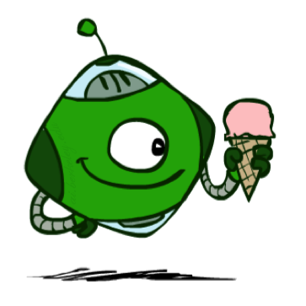
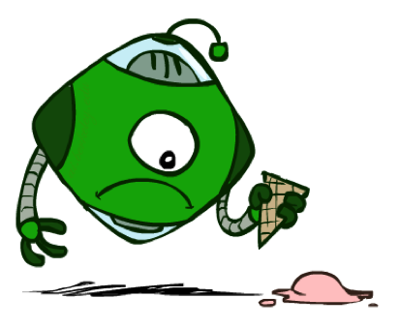
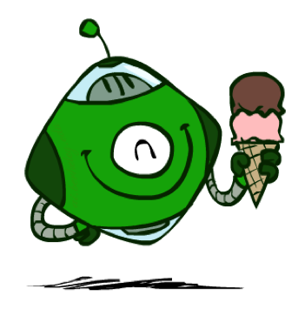
Utilities: Uncertain Outcomes
Getting ice cream
Get Single
Get Double
Oops
Whew!
Notes:
Make decisions among uncertain outcomes, not just scoops.
Order double scoop is dangerous. Might fall!

Slide 36
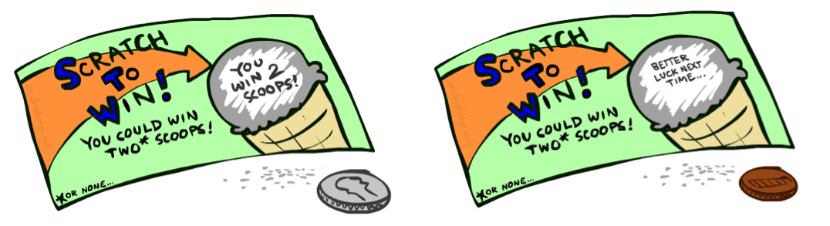
Preferences
A Prize
A Lottery
An agent must have preferences among:
Prizes: A, B, etc.
Lotteries: situations with uncertain prizes
Notation:
Preference:
Indifference:
A
p 1-p
A B
Notes:
Technical terms. A, B number of scoops.
Expectimax is big recursive lottery.
Not actual lottery – real lottery very complicated (we like to play). NO “and the fun of playing”.

Slide 37
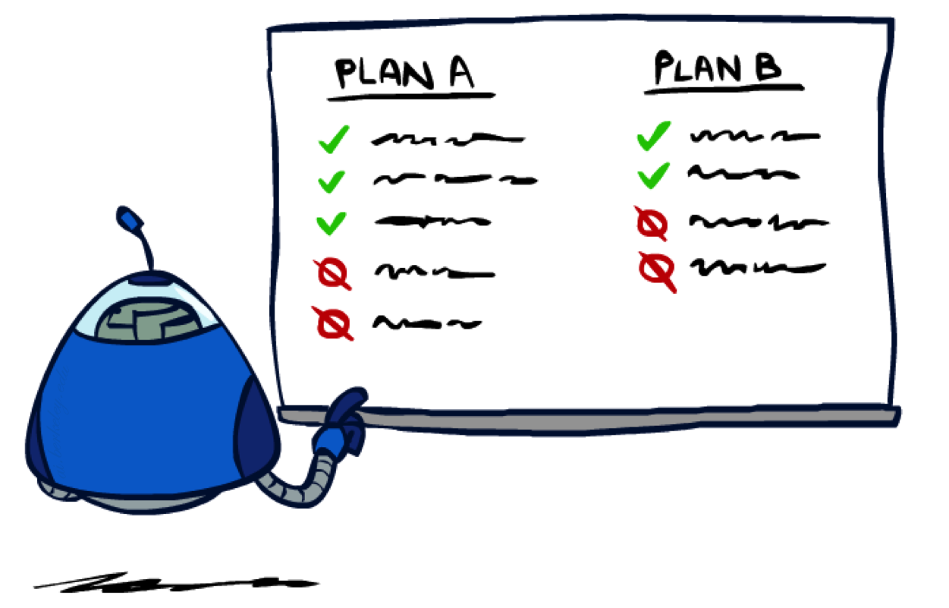
Rationality
Notes:
What does this mean in terms of preferences and lotteries?

Slide 38
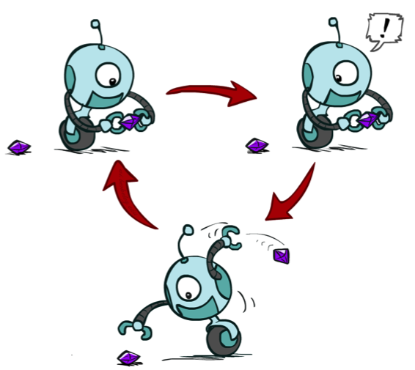
Rational Preferences
We want some constraints on preferences before we call them rational, such as:
For example: an agent with intransitive preferences can
be induced to give away all of its money
If B > C, then an agent with C would pay (say) 1 cent to get B
If A > B, then an agent with B would pay (say) 1 cent to get A
If C > A, then an agent with A would pay (say) 1 cent to get C
Axiom of Transitivity:
Notes:
Lots of preferences might be okay. Rational is technical term.
Make agent give away all it’s money.
Apple banana carrot.
SillyAgent starts with Carrot. Swaps for Banana, paying 1c to do so. Swaps for Apple, paying 1c to do so. Now has apple and paid 2c. Swaps for Carrot, paying 1c. Ends up paying 3c to end up where it was.

Slide 39

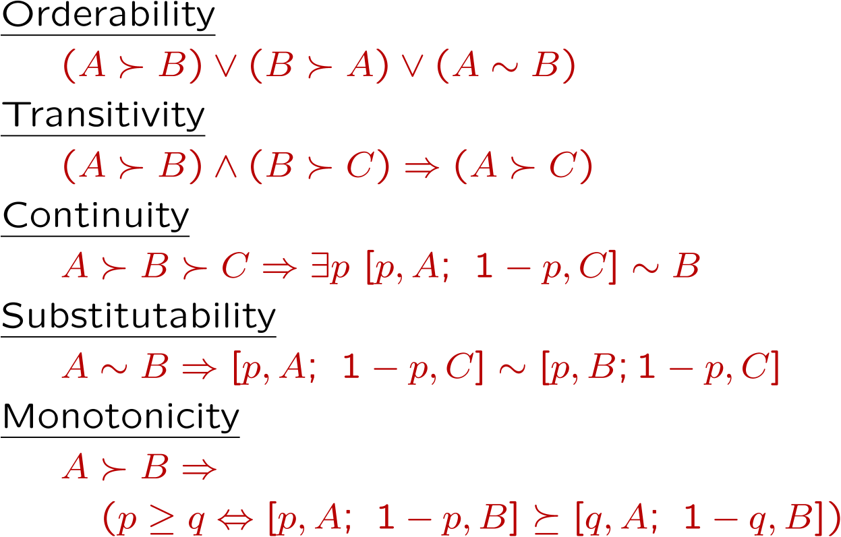
Rational Preferences
The Axioms of Rationality
Theorem: Rational preferences imply behavior describable as maximization of expected utility
Notes:
Like A better or like B better or indifferent
Already saw
B between A and C. There has to be a lottery between A and C such that lottery and B are equally preferable. Interpolate
If you’re indifferent between A, B, you are also indifferent to equal lotteries involving A and B.
If A>B and you have a lottery between A and B, you want more A in the mix (e.g. higher prob on A than on B).
If you accept, all prefs can be described by utility fn.

Slide 40
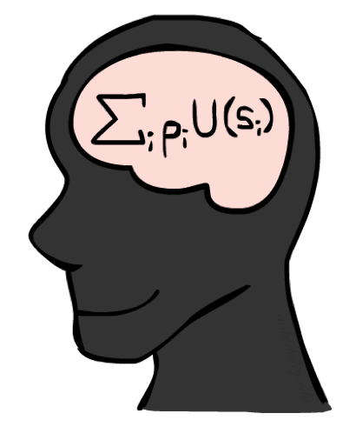
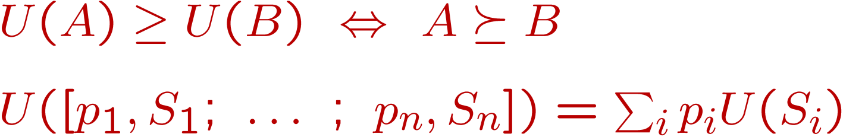
MEU Principle
Theorem [Ramsey, 1931; von Neumann & Morgenstern, 1944]
Given any preferences satisfying these constraints, there exists a real-valued
function U such that:
I.e. values assigned by U preserve preferences of both prizes and lotteries!
Maximum expected utility (MEU) principle:
Choose the action that maximizes expected utility
Note: an agent can be entirely rational (consistent with MEU) without ever representing or manipulating utilities and probabilities
E.g., a lookup table for perfect tic-tac-toe, a reflex vacuum cleaner
Notes:
~10:45
If you accept axioms…
Ordinal preferences
Util of lottery is expectation of the utils of lottery.
Pretty amazing. Can encode ANY preferences that meet axioms as a function that returns just a number.
You can be reduced to a utility function UNLESS you violate axioms. Hard to find it, though.

Slide 41
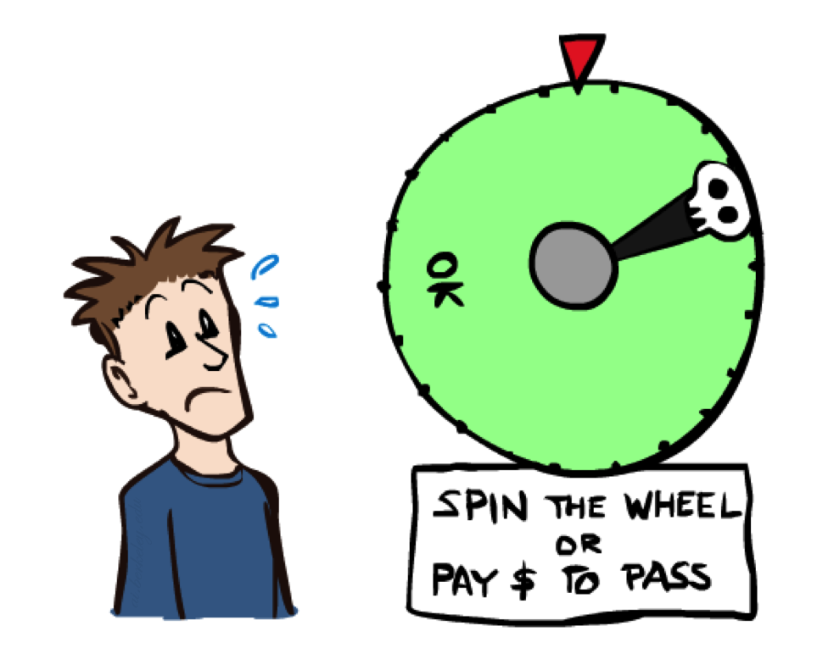
Human Utilities
Notes:
There IS a utility function for humans if you believe axioms!

Slide 42

Utility Scales
Normalized utilities: u₊ = 1.0, u₋ = 0.0
Micromorts: one-millionth chance of death, useful for paying to reduce product risks, etc.
QALYs: quality-adjusted life years, useful for medical decisions involving substantial risk
Note: behavior is invariant under positive linear transformation
With deterministic prizes only (no lottery choices), only ordinal utility can be determined, i.e., total order on prizes
Notes:
Difficult, serious consequences.
Morbid.
Want transparent.
Just ordering enough for minimax. Need more for expectimax. How do we do it?

Slide 43


Human Utilities
Utilities map states to real numbers. Which numbers?
Standard approach to assessment (elicitation) of human utilities:
Compare a prize A to a standard lottery L_{p} between
“best possible prize” u₊ with probability p
“worst possible catastrophe” u₋ with probability 1-p
Adjust lottery probability p until indifference: A ~ L_{p}
Resulting p is a utility in [0,1]
Pay $30
0.999999 0.000001
No change
Instant death
Notes:
Hard!
Take human and ask questions about various things, describe preferences.
Slide p until human is indifferent.
How much do you want to not pay $30.
It’s a micromort.
If it were higher, prob changes. Not just prizes, but probs.

Slide 44
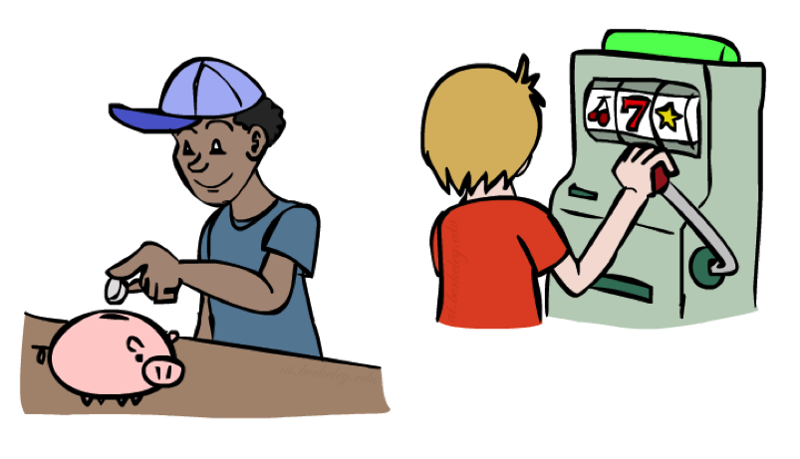
Money
Money does not behave as a utility function, but we can talk about the utility of having money (or being in debt)
Given a lottery L = [p, $X; (1-p), $Y]
The expected monetary value EMV(L) is p*X + (1-p)*Y
U(L) = p*U($X) + (1-p)*U($Y)
Typically, U(L) < U( EMV(L) )
In this sense, people are risk-averse
When deep in debt, people are risk-prone
Notes:
Money does NOT behave as utility function.
EMV is not utility. Just dollars.
Rather have sure thing with small return than chance a lottery with higher expected return.
When in debt, reverses.

Slide 45
Money vs. Utility
+U
+$
Notes:
What’s the shape of this graph? Hint: if it were a straight line, money would be a util fn, and I just said it wasn’t.
But more money is good and less money is bad.

Slide 46
Money vs. Utility
Notes:
Real data.
Asymmetric Diminishing returns. If you have a lot, a bit more isn’t a big deal. After first billion, second billion isn’t too good.
Things can only get so bad, so levels offs.

Slide 47
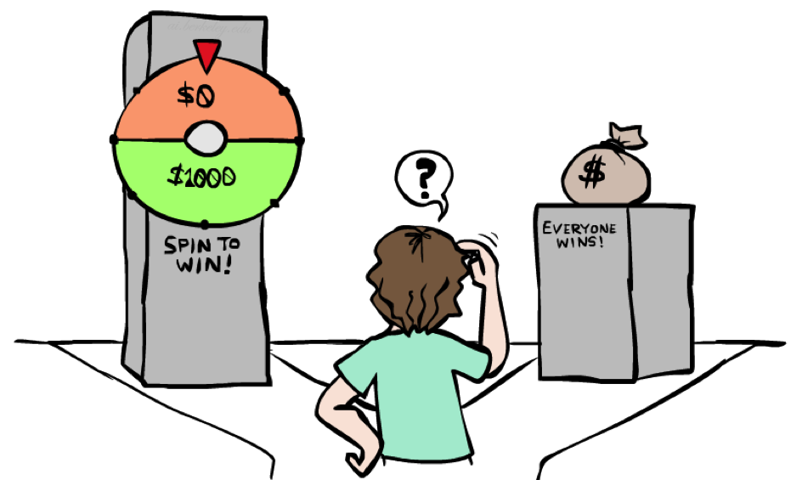
Example: Insurance
Consider the lottery [0.5, $1000; 0.5, $0]
What is its expected monetary value? ($500)
What is its certainty equivalent?
Monetary value acceptable in lieu of lottery
$400 for most people
Difference of $100 is the insurance premium
There’s an insurance industry because people will pay to reduce their risk
If everyone were risk-neutral, no insurance needed!
It’s win-win: you’d rather have the $400 and the insurance company would rather have the lottery (their utility curve is flat and they have many lotteries)
Notes:
50% chance of computer getting stolen.
How much would you pay to avoid this choice?
Who would trade for $10? Nobody. $900? Everybody! $400? Lower than expected, but not a lot lower.
Is it a scam? Nope. If you’re honest about preferences.
$100 is nothing to them, plus they have lotsa of lotteries.

Slide 48

Example: Human Rationality?
Famous example of Allais (1953)
A: [0.8, $4k; 0.2, $0]
B: [1.0, $3k; 0.0, $0]
C: [0.2, $4k; 0.8, $0]
D: [0.25, $3k; 0.75, $0]
Most people prefer B > A, C > D
But if U($0) = 0, then
B > A ⇒ U($3k) > 0.8 U($4k)
C > D ⇒ 0.8 U($4k) > U($3k)
Notes:
Actual experiments.
I don’t know utility, but util of 0 is 0.
Computational rationality? Did I do something wrong? Are you rational?
In A, you get the feeling of stupidity.
Model is oversimpified. More than money.

Slide 49
Next Time: MDPs!

Slide 50
What are Probabilities?
Objectivist / frequentist answer:
Averages over repeated experiments
E.g. empirically estimating P(rain) from historical observation
Assertion about how future experiments will go (in the limit)
New evidence changes the reference class
Makes one think of inherently random events, like rolling dice
Subjectivist / Bayesian answer:
Degrees of belief about unobserved variables
E.g. an agent’s belief that it’s raining, given the temperature
E.g. pacman’s belief that the ghost will turn left, given the state
Often learn probabilities from past experiences (more later)
New evidence updates beliefs (more later)

Slide 51
Uncertainty Everywhere
Not just for games of chance!
I’m sick: will I sneeze this minute?
Email contains “FREE!”: is it spam?
Tooth hurts: have cavity?
60 min enough to get to the airport?
Robot rotated wheel three times, how far did it advance?
Safe to cross street? (Look both ways!)
Sources of uncertainty in random variables:
Inherently random process (dice, etc)
Insufficient or weak evidence
Ignorance of underlying processes
Unmodeled variables
The world’s just noisy – it doesn’t behave according to plan!
Compare to fuzzy logic, which has degrees of truth, rather than just degrees of belief

